Slide 1

Doub less Living!
The Gospel of
LUKE
That you may have certainty!

Slide 2
A state of utmost bliss
Supreme blessedness
Exalted happiness

Slide 3
Beatitude
A state of utmost bliss
Supreme blessedness
Exalted happiness

Slide 4
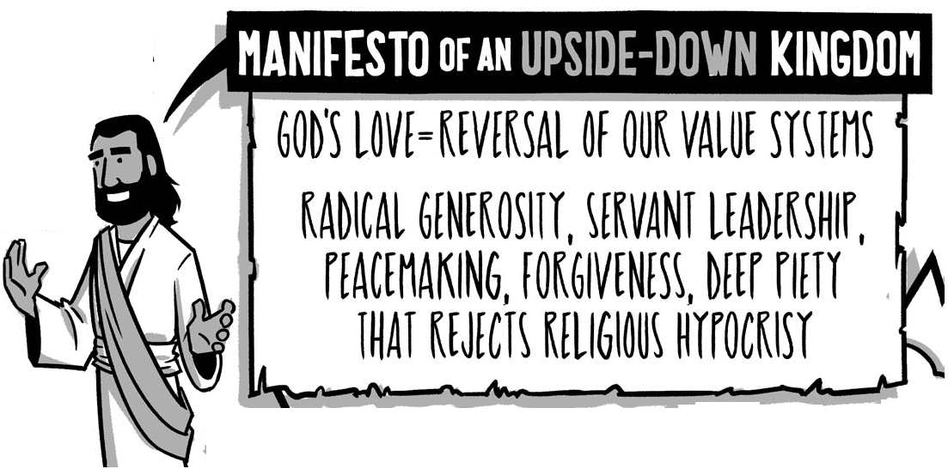

The Sermon On the Plain Part 1: Blessings & Woes
Luke 6:17-23

Slide 5
the Sermon
On the Plain
Four Parts
Righteous Response (6:39-49)
Teaching & Healing (6:17-19)
Love & Judgment (6:27-38)
Blessings & Woes (6:20-26)
Luke 6:17-49

Slide 6
the Sermon
On the Plain
Four Parts
Teaching & Healing (6:17-19)
Blessings & Woes (6:20-26)
Luke 6:17-49

Slide 7
Teaching & Healing
¹⁷ After coming down with them, he stood on a level place with a large crowd of his disciples and a great number of people from all Judea and Jerusalem and from the seacoast of Tyre and Sidon. ¹⁸ They came to hear him and to be healed of their diseases; and those tormented by unclean spirits were made well. ¹⁹ The whole crowd was trying to touch him, because power was coming out from him and healing them all.
Luke 6:17-19
When and where does this scene happen?

Slide 8
Teaching & Healing
¹⁷ After coming down with them, he stood on a level place with a large crowd of his disciples and a great number of people from all Judea and Jerusalem and from the seacoast of Tyre and Sidon. ¹⁸ They came to hear him and to be healed of their diseases; and those tormented by unclean spirits were made well. ¹⁹ The whole crowd was trying to touch him, because power was coming out from him and healing them all.
Luke 6:17-19
When and where does this scene happen?

Slide 9
Teaching & Healing
¹⁷ After coming down with them, he stood on a level place with a large crowd of his disciples and a great number of people from all Judea and Jerusalem and from the seacoast of Tyre and Sidon. ¹⁸ They came to hear him and to be healed of their diseases; and those tormented by unclean spirits were made well. ¹⁹ The whole crowd was trying to touch him, because power was coming out from him and healing them all.
Luke 6:17-19
Who was with Jesus at the time?

Slide 10
Teaching & Healing
¹⁷ After coming down with them, he stood on a level place with a large crowd of his disciples and a great number of people from all Judea and Jerusalem and from the seacoast of Tyre and Sidon. ¹⁸ They came to hear him and to be healed of their diseases; and those tormented by unclean spirits were made well. ¹⁹ The whole crowd was trying to touch him, because power was coming out from him and healing them all.
Luke 6:17-19
Who was with Jesus at the time?

Slide 11
Teaching & Healing
¹⁷ After coming down with them, he stood on a level place with a large crowd of his disciples and a great number of people from all Judea and Jerusalem and from the seacoast of Tyre and Sidon. ¹⁸ They came to hear him and to be healed of their diseases; and those tormented by unclean spirits were made well. ¹⁹ The whole crowd was trying to touch him, because power was coming out from him and healing them all.
Luke 6:17-19
Why were they there? What drew them to Jesus?

Slide 12
Teaching & Healing
¹⁷ After coming down with them, he stood on a level place with a large crowd of his disciples and a great number of people from all Judea and Jerusalem and from the seacoast of Tyre and Sidon. ¹⁸ They came to hear him and to be healed of their diseases; and those tormented by unclean spirits were made well. ¹⁹ The whole crowd was trying to touch him, because power was coming out from him and healing them all.
Luke 6:17-19
Why were they there? What drew them to Jesus?

Slide 13
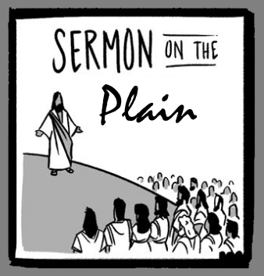

The Setting
A large crowd from as far away as Sidon (50 miles North) and Jerusalem (85 miles South)
All who touched Jesus were healed by the power flowing out from Him.
Jesus had a captivated audience, eager to hear what He had to say.
Doub less Living! © 2019

Slide 14
Blessings: The Beatitudes
²⁰ Then looking up at his disciples, he said: Blessed are you who are poor, because the kingdom of God is yours. ²¹ Blessed are you who are now hungry, because you will be filled. Blessed are you who weep now, because you will laugh. ²² Blessed are you when people hate you, when they exclude you, insult you, and slander your name as evil because of the Son of Man. ²³ "Rejoice in that day and leap for joy. Take note — your reward is great in heaven, for this is the way their ancestors used to treat the prophets.
Luke 6:20-23
What word jumps off the page at you when you read this passage?

Slide 15
Blessings: The Beatitudes
²⁰ Then looking up at his disciples, he said: Blessed are you who are poor, because the kingdom of God is yours. ²¹ Blessed are you who are now hungry, because you will be filled. Blessed are you who weep now, because you will laugh. ²² Blessed are you when people hate you, when they exclude you, insult you, and slander your name as evil because of the Son of Man. ²³ "Rejoice in that day and leap for joy. Take note — your reward is great in heaven, for this is the way their ancestors used to treat the prophets.
Luke 6:20-23
What does Jesus mean by blessed?

Slide 16
Blessings: The Beatitudes
²⁰ Then looking up at his disciples, he said: Blessed are you who are poor, because the kingdom of God is yours. ²¹ Blessed are you who are now hungry, because you will be filled. Blessed are you who weep now, because you will laugh. ²² Blessed are you when people hate you, when they exclude you, insult you, and slander your name as evil because of the Son of Man. ²³ "Rejoice in that day and leap for joy. Take note — your reward is great in heaven, for this is the way their ancestors used to treat the prophets.
Luke 6:20-23
Why did Jesus say they were blessed?

Slide 17
Blessings: The Beatitudes
²⁰ Then looking up at his disciples, he said: Blessed are you who are poor, because the kingdom of God is yours. ²¹ Blessed are you who are now hungry, because you will be filled. Blessed are you who weep now, because you will laugh. ²² Blessed are you when people hate you, when they exclude you, insult you, and slander your name as evil because of the Son of Man. ²³ "Rejoice in that day and leap for joy. Take note — your reward is great in heaven, for this is the way their ancestors used to treat the prophets.
Luke 6:20-23

Slide 18
Promise to Disciples
Present
Future
Heaven
They were already citizens of the Kingdom.
His disciples had already given up everything to follow Him.
Jesus contrasted their present state with their future.
Poor
Filled
Hungry
Happy
Sad
Rewarded
Hated

Slide 19
Two Sermons or One?
Characteristic | Sermon on the Mount | Sermon on the Plain
Scripture Passage | Matthew 5:1-12 | Luke 6:20-49
Location | On the mountain | On a plain at the foot of the mountain
Timing | Before choosing the Apostles | After choosing the Apostles
Focal Theme | Eight (8) character traits essential to happiness and influence for citizens of God’s Kingdom. | Four (4) social situations that illustrate the hope of God’s transformation and blessing to all who come to receive it.
Warnings (Woes) |  | Four (4) social situations that illustrate the consequences of rejecting God’s transformational offer.
We don’t know for sure, but Luke’s purpose for including the sermon seems to be very specific, as shown by the next passage.

Slide 20
²⁴ But woe to you who are rich, for you have received your comfort. ²⁵ Woe to you who are now full, for you will be hungry. Woe to you who are now laughing, for you will mourn and weep. ²⁶ Woe to you when all people speak well of you, for this is the way their ancestors used to treat the false prophets.
Warnings: Self-Reliance
Luke 6:24-26
What word stands out to you in this passage?

Slide 21
²⁴ But woe to you who are rich, for you have received your comfort. ²⁵ Woe to you who are now full, for you will be hungry. Woe to you who are now laughing, for you will mourn and weep. ²⁶ Woe to you when all people speak well of you, for this is the way their ancestors used to treat the false prophets.
Warning: Self-Reliance
Luke 6:24-26
What does “woe” mean in this context?
Woe (“ouai”) is an exclamation of pain or pity for the misfortune that awaits someone.

Slide 22
Warning: Self-Reliance
Present
Future
Rich
Remember, Jesus is speaking primarily to His disciples.
One of His main points is “do not live as those on the outside live.”
Your values are not to be their values, which bring woe.
Satisfied
Poor
Happy
Hungry
Loved
Sad
Hated

Slide 23

Deliberate Discipleship
God’s blessing is on those who come to Him to receive what He generously offers, and that blessing knows no socio-economic limitation.
The beatitudes declare God’s promised acceptance of His disciples for choosing to follow Jesus.
God’s call in the sermon is to be responsive to Him, to trust his care, and to rest in his promise instead of relying on ourselves.
Everyone here today falls into one of the two camps; the question is, which one?

Slide 24
The Sermon On the Plain Part 2: Love & Judgment and Righteous Response
Luke 6:17-23

